Slide 1
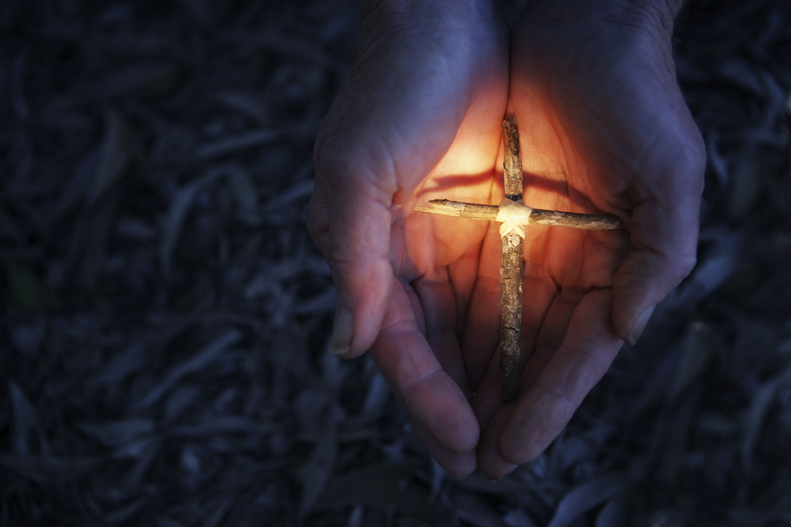
MEDITATION
A SALESIAN UNDERSTANDING
Fr. Eunan McDonnell, SDB
Notes:
Let us not forget that a Salesian contribution to meditation is one that stands within the current of the contemplative tradition in the Church – St Francis de Sales (Doctor of the Church) – who is a school of spirituality unto himself – is someone who is educated by the Jesuits (Clermont) – spiritual exercises also his directors were jesuits (in Padua Possevin)(Ignatian tradition) influenced by Mme Acarie and had originally intended to bring the Carmelites to France before Berulle as well as Jane Frances de Chantal who was friends with the carmelites in Dijon (Carmelite tradition) – is well versed in the Fathers of the Church (Patristic tradition) and exposed to the Benedictine tradition (through lectures given by Genebrard) and an aficionado of St Bernard of Clairvaux (Cistercian tradition) – all of which is filtered through his lived experience of his own relationship with God and his spiritual direction to both lay and religious.

Slide 2
MEDITATION QUESTIONS
WHY do we meditate?
What is the origin of the word meditation?
ATTENTION
God desires to communicate with us
Notes:
Often we like to know How to meditate before we ask the more primary question:
Why do we meditate?
Let’s begin with the actual word meditation – it is derived from the same word as medecine – which simply means to give care or attention to.
In Christian meditation we are giving attention to or bringing our attention to – the awareness of God’s presence.
God is never absent – we are – God is always present – as St Teresa of Avila remind us – if we give ‘attention’ to our vocal prayer it can very quickly lead us into meditation – the key is attention.
This brings us to a fundamental tenet of Salesian Spirituality – God Desires to communicate with us – his first visitation is in creation and the Second in the incarnation.
When we choose to meditate we do so in response to God who is inviting us into a deeper intimacy with him, but this requires attentiveness on our part.
God is the one who always takes the initiative in prayer – our task is to respond.

Slide 3


SONG OF SONGS
Divine Romance –
The lover Seeking His lost love
Pope Benedict XVI
What have I learnt
about God
that I haven’t been told?
(Pinto)
ENCOUNTER
Notes:
If we want to understand Salesian Meditation we need to have recourse to the Biblical perspective presented in the Song of Songs – which is a love poem – whose predominant images are about the lover seeking the beloved - the story of God’s seeking out his lost love, the highest possible romance – Pope Benedict XVI
In his own lived experience – before he entered his crisis at 19 – St FdeS’s view of God was revolutionized through the lectures on the Song of Songs given by Genebrard – At this point, he discovers that we are involved in a loved story where ‘God is constantly seeking his lost love’ (This accounts for the incarnation and the sending of the Spirit, who are the two arms through which the Father reaches out to us to bring us back into his embrace – St Irenaeus)
True spirituality or Theology ultimately is biographical – it has to be connected to our lived experience to our lives to our personal relationship with God – or else it is simply ideas about God – The Introduction to the Devout Life and the Treatise on the Love of God are an explication of this fundamental reality that God is love.
What have I learnt about God that I haven’t been told? (Pinto) – In other words, as Pope Francis keeps reminding us it is about ENCOUNTER – This is the purpose of meditation – to encounter God who is always present to us – to allow ourselves to be loved by God (St Elizabeth of the Trinity)

Slide 4


Attention to the Beloved
We withdraw to encounter
God within, not to close in
on ourselves.
Through our dedication
to prayer we deepen our
friendship with Christ
GOD our TIRE-COEUR.
Notes:
St Teresa of Avila and Francis de Sales – prayer is friendship with Christ (encounter) – prayer - ‘spending time alone with him whom we know loves us’ –
Prayer is a transforming experience – St Francis de Sales uses the image of a magnet,
Just as a piece of metal takes on the properties of the magnet that attracts or draws it – so too, through prayer we are magnetised by God, made in his image we become more conformed to his likeness – (God=Tire-coeur)
We here a lot of talk about ‘mindfulness’ nowadays – it is simply giving attention to (mediation) but for FdeS it is always mindfulness of someone or giving attention to someone – specifically to Christ so that we deepen our mutual love -

Slide 5


Without constant prayer…
God vanishes in the distance… becomes an idea… if we stop praying God “dies” not in himself but in our hearts… like a withered plant we have neglected to water.
Do Young People see in us people who have “put aside personal prayer, saying we have to search for God in humanity; and in looking for God, we have abandoned God?” ’
Ignacio Larrañaga
Notes:
the less we pray, the more God vanishes into the distance. He slowly becomes a meaningless and lifeless “idea.” No one wants to be, to relate, or to live with an idea; nor does it stimulate us in times of struggle or challenge. This is how God stops being Someone and is diluted to the point of being a distant and absent reality… if we stop praying for a long period of time, God “dies!” … not in himself, but He dies in our hearts. God “dies” like a withered plant we have neglected to water. Ignacio Larrañaga.

Slide 6

HEART PROBLEMS
ALL OF OUR DIFFICULTIES IN PRAYER ARE
HEART PROBLEMS
OUR HEART IS NOT IN IT,
WE MAKE EXCUSES,
WE DON’T COME
WITH LONGING
AND DESIRE
HOW DO I ENGAGE MY HEART?
Notes:
Being there for God shifts the centre of gravity away from ourselves to God
This is experienced particularly as prayer deepens because there is the movement from the realm of the senses to the realm of the spirit – consequently – one can rely no longer on feelings in prayer – this purifies our desire – are we being present to God or simply there because of what we are getting out of it – as FdeS would say – we have to learn to seek not the consolations of God but the God of consolations.
ENGAGE YOUR WILL

Slide 7

HOW TO MEDITATE
CARDINAL BASIL HUME – how long do you pray?
PREPARATION is essential
A METHODLESS METHOD
What interior attitudes or
dispositions of heart can help us
to receive the gift of prayer?
“ half an hour’s meditation is needed,
but if you are busy…
Then an hour!” Francis de Sales
Notes:
1.When Cardinal Basil Hume was asked how long do you pray for each day? He scandalised some people by responding – 5 minutes! He went on to clarify that he spends 55 minutes in preparation for his 5 minutes of prayer!
2. Just as physical exercises require warm up exercises, so too, prayer requires preparation.
3. Often you may hear it argued that with Salesian Method there is no ‘technique’ that both FdeS and JdeC recommend a ‘methodless method.’ I would preface this with a word of caution – it is true that they both emphasize that it is not technique but a matter of relationship so we are dealing with heart speaking to heart –The best method of prayer is not to have any method, because prayer is not obtained through a technique but through grace. Jane de Chantal
HOWEVER – at the initial stages of the prayer-relationship, FdeS recommends particular methods that are helpful for beginners (very much in line with Jesuitical imaginative prayer) as illustrated to Mme de Charmoisy in The Introduction. It is constructing a building that requires scaffolding, but as the building develops the scaffolding has served its purpose and can be removed – or like learning to become proficient on the piano – one has to learn the rules initially, but once these have been internalized, then, one can express one’s own creativity.
4. What interior attitudes or dispositions of heart can help us to receive the gift of prayer … faith, trust, fidelity and perseverance -
Prayer is an art – we learn to pray by praying – the practice is indispensable. St Francis de sales says in the Devout life (and remember this is written for laity not for religious – so his expectations of religious is even higher!!!) We are like a clock no matter how good it may be, it needs resetting and rewinding twice a day, once in the morning and once in the evening. (St Francis de Sales)
But what if you are very busy?
A half an hour of meditation is necessary, but if you are busy, then you need an hour.

Slide 8

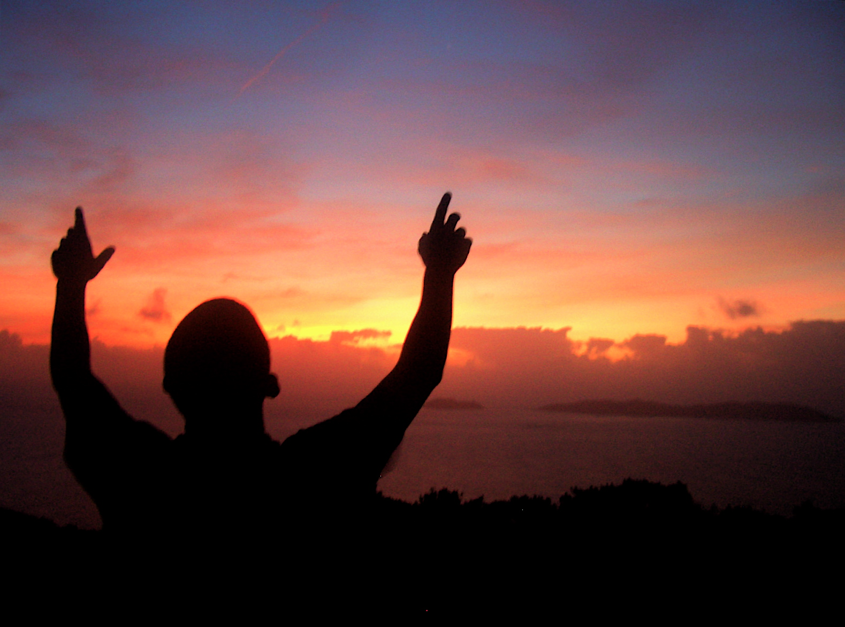
HEART PREPARATION
when you prepare to pray you must say with your whole heart and in your heart, “
O my heart, my heart, God is truly there.”
PRAYER AS RESPONSE
Too
Notes:
As stated earlier – for St Teresa (Interior Castle) God is indwelling – St John of the Cross (the kingdom of God is within you – inner secret/hidden chamber) – St Francis de Sales (you are the paradise of God)
Reditus ad Cor – of Monastic life - The journey home is a journey to the heart – Monastic life is like a finger pointing within, indicating the path that leads to the deepest centre, to the true self the path of reditus ad cor. When we return to the heart, we return to ourselves, we claim the interior lanscape of the heart as our own.
Monastic life is essentially a process of awakening the dormant heart, liberating the life within us, and following its lead. Jean Marie Howe
Cf. FdeS instruction to Jane Frances de Chantal – that her heart would be her monastery and Mary would be her Abbess – while she was discerning her call to religious life.

Slide 9
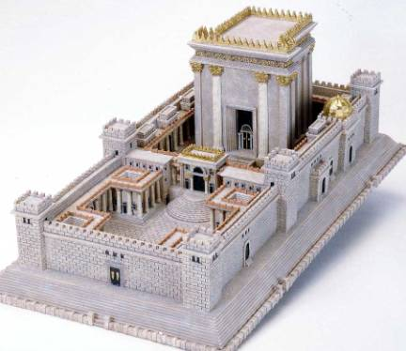

Our Heart: the Temple of our being
YOUR
HEART
AS
COMPASS
Notes:
ANALOGY- the steps in SACRO CUORE TO THE BASEMENT –
For St Teresa of Avila and St Francis de Sales – we cannot bypass the humanity of Christ – it is through Jesus we have access to the Father – as it is their mutual Spirit of Love that has been poured into our hearts.
Our Lord is not distant but very near to us. (TERESA OF AVILA)
God is not only near to us, but he is dwelling within us. God is dwelling in our heart. Just as God has created this world to be our paradise, so too, has he created your heart to be his paradise. (St Francis de Sales)
‘God within’ – but also ‘we are within God’ like birds in the air; or fish in the sea.

Slide 10

FREQUENT COMMUNICATION
PRAYER IS … spending time frequently alone with Him whom we know loves us. (St Teresa)
Frequently …
expresses commitment –
It is better to pray badly than
`not to pray’ at all.
Regular prayer develops
the spirit or habit of prayer
René Voillaume
Notes:
Get used to praying, don’t be waiting for the desire to come or when you feel like it … The less we pray, the less well we pray and the less we will desire it. Regular prayer develops the spirit or habit of prayer. René Voillaume
The Lord repeats and repeats, and keeps coming back to the subject with different parables, all bearing on the same theme — so much so that the discovery is almost disappointing! René Voillaume

Slide 11
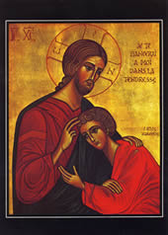
Contemplative Practice
… as the body needs sleep, so too does the soul…
I will allot a certain time each day, like the beloved disciple to rest on the loving heart of our Saviour…
Listening to the heartbeat of God.
Notes:
Let us return to our Salesian understanding of prayer as ‘heart to heart’ – it is the Heart of God who is drawing us into relationship to speak to and listen to his heart -
We often complain that God does not hear our prayers… yet frequently the truth is the other way around… Too often our hearts are set for transmission only, and incoming calls are not received. Fr Eugene McCaffrey OCD

Slide 12

DISCOVERING GOD
IN THE MONASTERY OF
THE DEVOUT LIFE, WE ARE
ALWAYS NOVICES (St Francis de Sales)
If all you do is return to
God’s presence after distraction,
then this is very good prayer.
Your persistence shows
how much you want to be with God.
(St Francis de Sales)
Notes:
1. prayer is as much about unlearning as learning; letting go in order to receive. There can be an important difference between my ideas about God and the God I meet in prayer - when you go on retreat, leave God behind (Ruth Burrows)
An indication that God is truly present will be the element of Surprise – this is God’s Spirit at work – mental prayer involves listening, truly listening – when we speak we already know what it is we want to communicate; when we truly listen we learn something new. So it is with God – as we enter more deeply into the mystery of God, we have to become childlike in order to receive –
2. Distractions - It’s natural to become distracted during prayer sometimes. If you can, simply acknowledge the distracting thought and let it go. Sometimes, however, what at first seems like a distraction offers an opportunity for a graced encounter with God. Thus, if the distracting thought continues, then carefully discern whether it’s really a distraction or something you need to pray about/ also Spiritual Direction.
We must avoid the pitfall of trying to evaluate or judge our prayer (although I will be recommending a review of our prayer). Imagine rating each time you spent with a friend or loved one!) God can put anything to good use, even distractions and preoccupations. Such evaluations can subtly bring the focus back to myself and away from God whom I am being called to be attentive to.
If we seek our own satisfaction, we will abandon prayer as soon as it becomes too difficult, or when we feel dryness or discontent, or when we no longer draw from prayer the pleasure we had expected.” Jacques Philippe

Slide 13
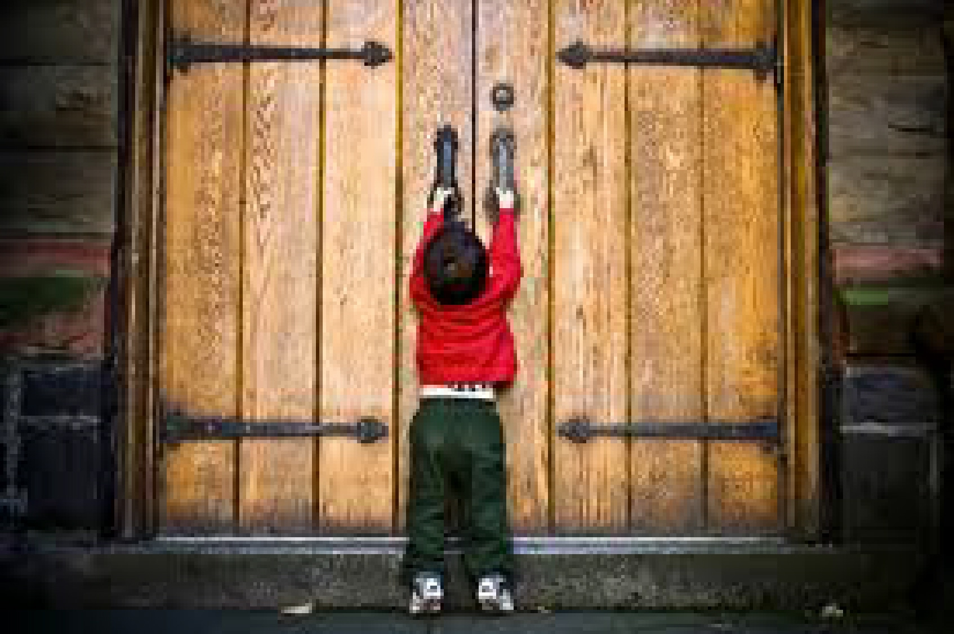
Our operative image of God
My personal history has a
bearing on how I see God
Often we project our own
feelings of not being loveable
unto God
We can end up withdrawing
farther from a God of our own
making, rather than
drawing closer to the God
who made us. James Martin
Notes:
The God we encounter in prayer can challenge our idea about God – The Word of God is alive and active, cuts more finely than a double-edged sword – It disturbs us when we are too comfortable; and comforts us when we are disturbed – sometimes to break through to the truth about God, we have to face the truth about ourselves – and that can be disturbing – especially, for our ego – This may be one of the reasons why I prefer to be immersed in activity – we avoid prayer because we may want to avoid a truth about ourselves which surfaces when we enter that quiet space for prayer.

Slide 14
Steps to aid MEDITATION
1. Preparation for Prayer –
PLACE YOURSELF IN THE PRESENCE OF GOD
(Be sure to invoke the Holy Spirit)
Become Centered
God is present in my heart
I Love you too…
Notes:
Place yourself in the presence of God. Remember that God is near, not far away. He is in the very depth of your heart, your spirit. ‘Begin all your prayers, whether mental or vocal, in the presence of God. Keep to this rule without any exception and you will quickly see how helpful it will be.’ A helpful way of guiding people in placing themselves in God’s presence is to begin with the mantra: ‘I love you too’. These words immediately conjure up the sense of already being loved by God and that I am responding to this love. The heart is already warmed in the truth of God’s love for us. No matter how much anyone loves us, their love comes to us from outside, they speak to our heart. Yet, only God is able to speak to us from within our heart. He dwells within us. He speaks to our heart from within. At the same time, we dwell in God who carries us in his heart and opens up his chamber of love to us.
OEA III:71.

Slide 15
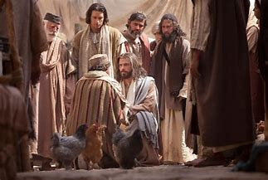
STEPS TO AID MEDITATION
Choose a scene from the Gospel and enter imaginatively into it
as an observer
Or
as a participant
Notes:
Choose a passage from Scripture, select a scene from the Gospel, a mystery of the Faith, or a passage from some spiritual reading. If the subject matter lends itself to it, imagine yourself in the same place as the action or event that is happening. For example, picture yourself in the midst of the scene near Jesus or with the disciples. Some people find using the imagination very helpful in prayer whereas others, even at the very beginning, have problems with discursive meditation.
Meditation for St Francis is not so much for study or to gain knowledge but to increase our love for God and enter more fully into discipleship. Again, like St Teresa, prayer is not about thinking much, but loving much, being present to Christ whom we know loves us.

Slide 16
Steps to aid MEDITATION
3. Meditate on Scripture above all because we are not seeking ideas but paying attention to God
So as to arouse ourselves to love/encounter Him
If good affections should rise up – gratitude for God’s mercy, awe at His majesty, sorrow for sin, desire to be more faithful, for example – yield to them.
Notes:
Meditate on Scripture, above all, because we are not simply thinking about ideas but encountering God in his Word. He writes: “In Holy Scripture the word meditation is ordinarily applied to the attention we pay to the things of God in order to arouse ourselves to love them… When we think upon the things of God, not to learn but rather to acquire affection for them, the act is called meditating and the exercise is mediation. Meditation is simply attentive thought voluntarily repeated or entertained in the mind in order to arouse the will to holy and salutary affections and resolutions.”

Slide 17
RESOLUTIONS
Thoughts repeated in the mind effect our affections which, in turn, lead to resolutions
Most of all, after you rise from meditation you must remember the resolutions and decisions you have made and carefully put them into effect on that very day. This is the great fruit of meditation and without it meditation is often not only useless but even harmful.
Transformation
Notes:
We see clearly in the Introduction to the Devout Life, how St Francis is anxious to transform Philothea's simple desire to live the gospel into a firm resolve to do so. This is why he underlines the necessity of resolutions that arise from the affections experienced in meditation. For example, resolve to be more faithful in prayer, or more ready to forgive, more eager to share the faith with others, or more determined to resist sin, in as practical and concrete a way as you can determine. “Most of all, after you rise from meditation you must remember the resolutions and decisions you have made and carefully put them into effect on that very day. This is the great fruit of meditation and without it meditation is often not only useless but even harmful. Virtues meditated on but not practiced sometimes inflate our minds and courage and we think that we are really such as we have thought and resolved to be.
TRANSFORMATION – without resolutions which engage the will and effect our choices – creates habits (virtuous habits) – then we run the risk of spiritual materialism -

Slide 18
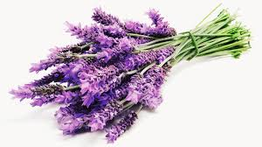
SPIRITUAL BOUQUET
Let us belong to God in the midst of so much busyness
Francis de Sales
Notes:
He is anxious that our meditation should perfume the day
It is related to the Salesian understanding of ‘aspirations’ or saying short spontaneous prayers throughout the day (withdraw into the heart in the midst of activity)

Slide 19



Hearts open to God in the midst of activity
We must learn to leave God for God Francis de Sales
Notes:
Why we meditate is so that our hearts may be filled with God that bears fruit in our activity – quoting St Bernard – FdeS warns that we must be reservoirs not channels of God’s love – The wise person will see his life as more like a reservoir than a canal. The canal simultaneously pours out what it receives; the reservoir retains the water till it is filled, then discharges the overflow without loss to itself ... Today there are many in the Church who act like canals, the reservoirs are far too rare ... You too must learn to await this fullness before pouring out your gifts, do not try to be more generous than God.”
When you have received Him in Holy Communion ... behave outwardly in such a way that your actions may give proof to all of His Presence…many are satisfied with carrying the Lord on their tongue… others carry Him in their hearts with affection
but these do not amount to much unless you carry Him in your arms by doing good to others. FdeS

Slide 20
TROUBLESHOOTING
When prayer is difficult ask:
Despite the dryness or darkness, is there still a desire within me to remain in prayer?
Do I rush in to prayer unprepared?
Is there something inconsistent with prayer going on in my life?
Has an area of woundedness surfaced that needs to be brought to the Lord for healing?
What is happening in my life outside of prayer?
Have I become the focus of my prayer?

Slide 21
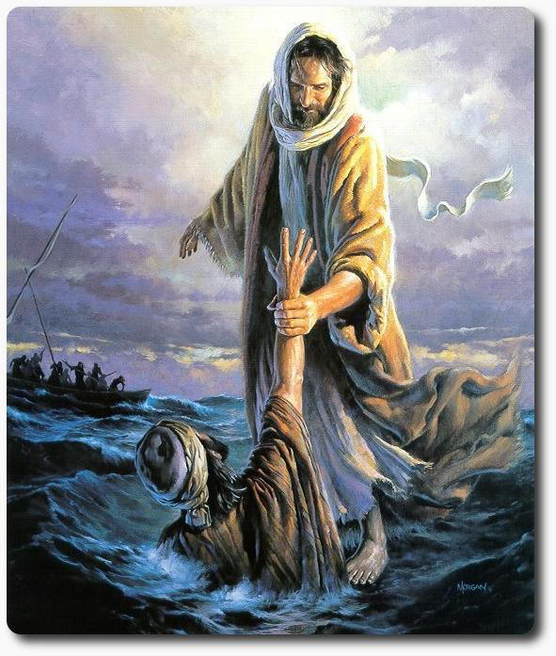
REVIEW OF PRAYER
The aim of the review is to see if we have moved from thinking about God to relating to God.
Did you meet God?
You are precious in my eyes and I love you Isa.43:4
Notes:
DO WE HAVE A LANGUAGE TO DESCRIBE OUR PRAYER OR ARE WE SPIRITUALLY ILLITERATE?
If I use words, I speak from where I am at in myself. Say, for example, I am affected by the word “precious” in Isaiah 43:4, “You are precious in my eyes and I love you”.
I tell the Lord how I am affected.
I may say: “I am not able to accept that I could be precious to you”;
or on the other hand,
I may find myself glad at knowing and feeling that I am “precious” to the Lord, and I may want to respond with “Thank You”, or “Yes, I accept that I am precious to you and I want to believe it more deeply”.
Having spoken, I might then wait for a response of some kind form the Lord, for a response may well be given, in some form. Finbarr Lynch, When You Pray, p.71

Slide 22
REVIEW OF PRAYER
Movement in prayer?
Does anything help you to give prolonged attention to the Lord?
A word or phrase or desire holding you?
Was there understanding or a felt understanding?
Bring up a truth, explore with the mind, and respond with the heart.
Get into a Gospel text in order to meet Jesus who is alive today.
Something repetitive can direct the heart towards God in faith.
How were God and I present/absent to one another?
Is there anything I want to go back to?

Slide 23
